Slide 1
OVERALL STRUCTURE OF DBMS

Slide 2
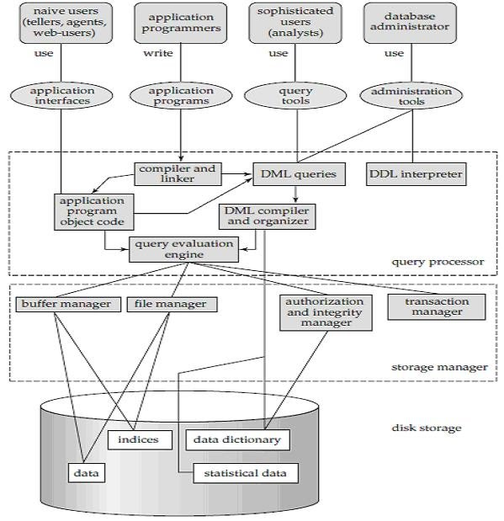

Slide 3
OVERALL STRUCTURE OF DBMS CONTI…
INCLUDE 4 MAIN COMPONENT:
1)USERS
2)QUERY PROCESSOR
3)STORAGE MANEGER
4) DISK STORAGE

Slide 4
1)USERS
Naive User:
This user not introducing with database directly. Introducing database through some navigators or application programmers.Eg. Tellers,agents,webuser.so it is mentioned as use.
Application Programmer :
Introducing db by writing programs or developing some programs. Such as java,.net,php,python etc…
Sophisticated user:
Directly interact with db. through some db. query language. So it is mentioned as analysis.
Database Administrator:
Use modern and cloud platform, to organise ,store, and protect critical data.
Create and maintain database standards.
Define security for database.
Design schemas, altering schemas, granting and revoking permissions these functions done by DBA

Slide 5
2) Query Processor
Application program object:
Application programmer write a program and send it for compilation and for execution and then create a Application program object code.
DML queries :
use database manipulation queries like update,delete,select etc..
Data Definition Language (DDL) Interpreter :
Interpreted DDL statements and fetch definition in data dictionary.
DML Compiler and Organizer :
Compiler translate DML statements into low level instructions that understand by query evaluation engine.
Then DML compiler select best plan for query optimization for same query results.
Query Evaluation Engine:
Execute low level instruction granted by DML compiler on DBMS.

Slide 6
3) Storage Manager/Storage Mgmt.
Buffer manager:
It manages the transfer of data between the secondary and main memory. It also decides what data should be cached in the memory
File manager
It manages the space allocation of files in disk and data structures which stores information in the database.
Authorization and Integrity Manager
It checks the authority of various users who access data and the Integrity Constraints of the database.
Transaction Manager
Its job is to assure the system remains in a proper state during the transaction process. It also ensures that concurrent transactions are executed without any conflict.

Slide 7
4) DISK STORAGE /STORAGE MGMT.
DATA:
It is physical data is kept by using some data structure on disk storage.
INDICES:
Provide fast access to data items it means where to go data, how to handle data.
DATA DICTIONARY:
Store statistical data structure and other information of data.
Kept in respective database storage.

